Slide 1
Lecture 4: Literature Review
WOX7001 Research Methodology

Slide 2
What is Literature Review?
A survey of scholarly sources on a specific topic
It provides an overview of current knowledge, allowing you to identify relevant theories,methods,and gaps in the existing research
As well as looking at what’s already known, it seeks to point out what isn’t yet known – often to provide a justification for your own research.
As part of a longer piece of research, it’s there to ensure you have a thorough understanding of the existing research in your area before embarking on your own.

Slide 3
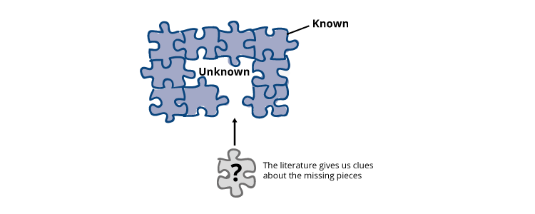
Why Write a Literature Review?
Helps to determine whether the topic is worth studying
Provides insight into ways in which the researcher can limit the scope to a needed area ofinquiry
Source: https://flexiblelearning.auckland.ac.nz/biomed-lit-review/12_2.html

Slide 4

Why Write a Literature Review?
When you write a thesis,dissertation,or research paper
Conduct a literature review to situate your research within existing knowledge
The literature reviewgives youa chance to:
demonstrate your familiarity with the topicand scholarly context
develop a theoretical framework and methodology for your research
position yourself in relation too the researchers and theorists
show how your research addresses a gap or contributes to a debate

Slide 5

How to Start?
Identify the research topic
Identify a topic to study
reflecton whether it is practical and useful to undertake the study
The topic is the subject or subject matter of a proposed study
e.g. “faculty teaching,” “organizational creativity,” or “psychologicalstress”
Describe the topic in a few words or in a short phrase
The topic becomes the central idea to learn about or to explore
© Coventry University. CC BY-NC 4.0

Slide 6
Extracting the Terms from Research Topic
Main domain – property pricing
Sub domain 1 – prediction
Issue - inaccuracy
Sub domain 2 – model
Issue – factors not been fully identified
Sub domain 3
issue
Main domain – manufacturing
Recommendation system
inaccuracy
Type of manufacturing
Human wellbeing
eyes
Machine related

Slide 7




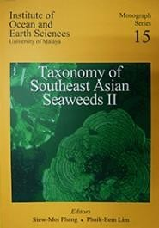

Types of Literature Sources
Primary Sources
Included all sources that are original
provide first-hand information that is closest to the object of study
vary by discipline
Peer reviewed research articles
Patent
Conference proceedings
Case studies
Interview
Dissertations/thesis
Newspapers (sometimes)
Secondary Sources
provides non-original or second- hand data or information
1. Review articles
Tertiary Sources
consists of distillation and collection of primary and secondary sources
Textbooks
Encyclopedias
Handbooks
The purpose of tertiary literature is to provide an overview of key research findings and an introduction to principles and practices within the discipline
Meta analysis
Monographs on a specificsubject

Slide 8
Structuring the LR
Main domain – working arrangement
Type
Hybrid
WFH
Issue
Management
Personal
Preferences
Main domain : Health
Sub domain : Type of health activities
Fitness Activity
Prediction: How helpful strength training for fat loss rather than cardio activities

Slide 9
Structuring the LR
Main Domain: Health
Sub Domain:
Physical
Marathon running
Working people
Non-working
List other physical activities
Mental Health
Physiological stresses
psychological stresses
Workplace stresses (need to refer where to slot this??)
Impact of the Covid-19 endemic on the changes in shopping behaviour in Malaysia
Main domain: Retailing
Sub domian:
Shopping behaviour
in-store shopping
curbside pickup
online shopping
Sub domain: factors determining the shopping behaviours
Fear of health
Employment status
Demographic
(suggestion only)

Slide 10


The Aim of Literature Review

Slide 11






The Aim of Literature Review
Develop the foundation of research base
To learn methods and approaches that are appropriate for your study
To learn appropriate theory to underpin your work
Provide guideline experimental setup
to design the
Assist to collect appropriate data

Slide 12

Some parameters to beconsidered:
Planning Your LiteratureSearch
How far back will you look for sources? The last 5years/10 years?
What source do you want to cover?
E.g. Journals/Patent /Governmentreport / Conference

Slide 13
If the topic is not very specific, seek clarification from your supervisor:
Roughly how many sources should need to include?
What types of sources (journal articles, websites)?
Should you evaluate yoursources?
Is the source you are using trusted in your field? (check using the Web of Science/Scopus)
Planning Your LiteratureSearch

Slide 14
Planning Your Literature Search
What should we do before writing the literature review?
Look for other literature reviews in the area of interest
Read them to get a sense for your own research
Find the ways to organize your reviews
Chronologically, Thematicaly,Methodologically
References are the excellent entry points
Hundreds or thousands of articles
Read in order to get a good survey of the materials
Should not expect to read everything in thefield
make your job easier by limiting the scope

Slide 15
Planning Your Literature Search
Four stages of the literature review:
Problem formulation – which topic or field is being investigated and what are the main issues?
Literature search – finding materials relevant to the subject being explored
Data evaluation – determining which literature makes a significant contribution to the understanding of the topic
Analysis and interpretation – discussing the findings and conclusions of literature

Slide 16
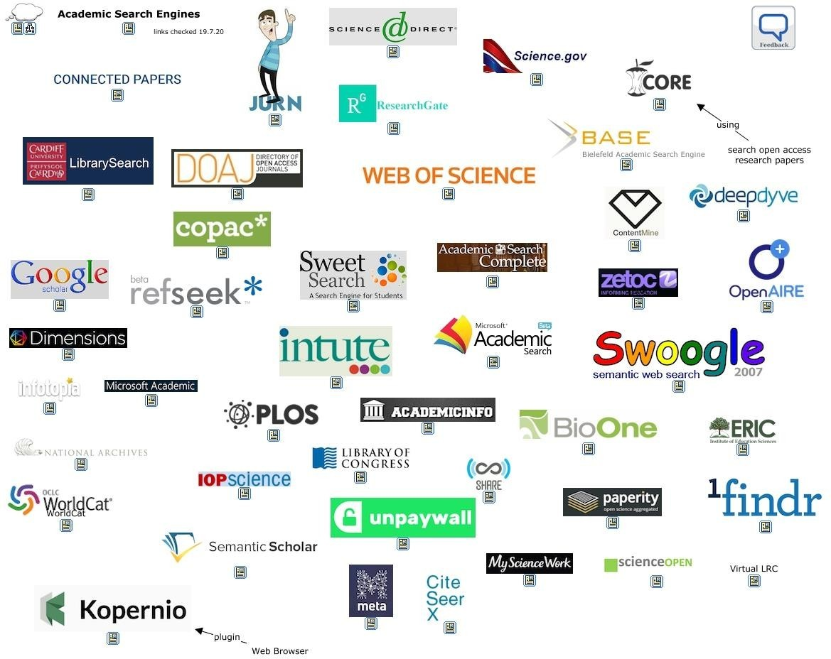
How to Find Literature (Academic SearchEngine)
Academic search engines have become the number one resource to turn to in order to find research papers and other scholarly sources.
Adapted from: https://cmapspublic3.ihmc.us/rid=1MLZQQ750- 1C2D36P-B8DY/1QPP3T4ZGITT4PYBIR5LYItextIhtml

Slide 17
Indexing
WOS (Web of Science)
Scopus
Google Scholar
Academia

Slide 18
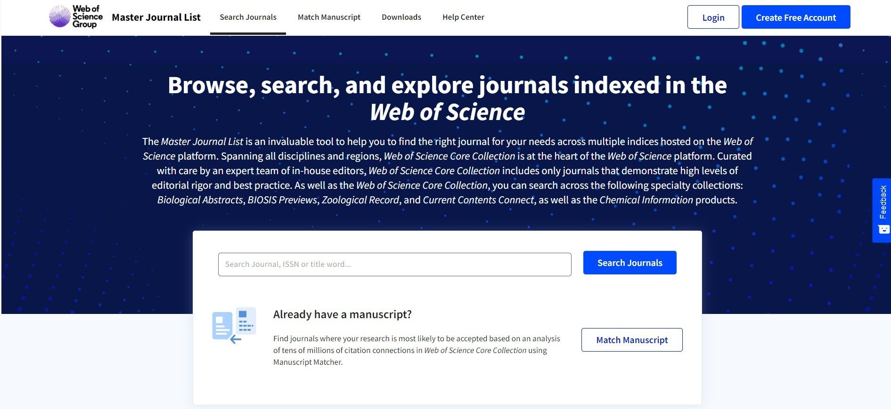
How to Find Literature (Academic SearchEngine)
1. Web of Science
Web of Science is the most powerfuland trusted search engine
Access toWeb of Science is onlyavailable toUM communitywith active Library memberships
Step 1. Go to Master Journal List website:
https://mjl.clarivate.com/homeand clickon “SearchJournals”

Slide 19
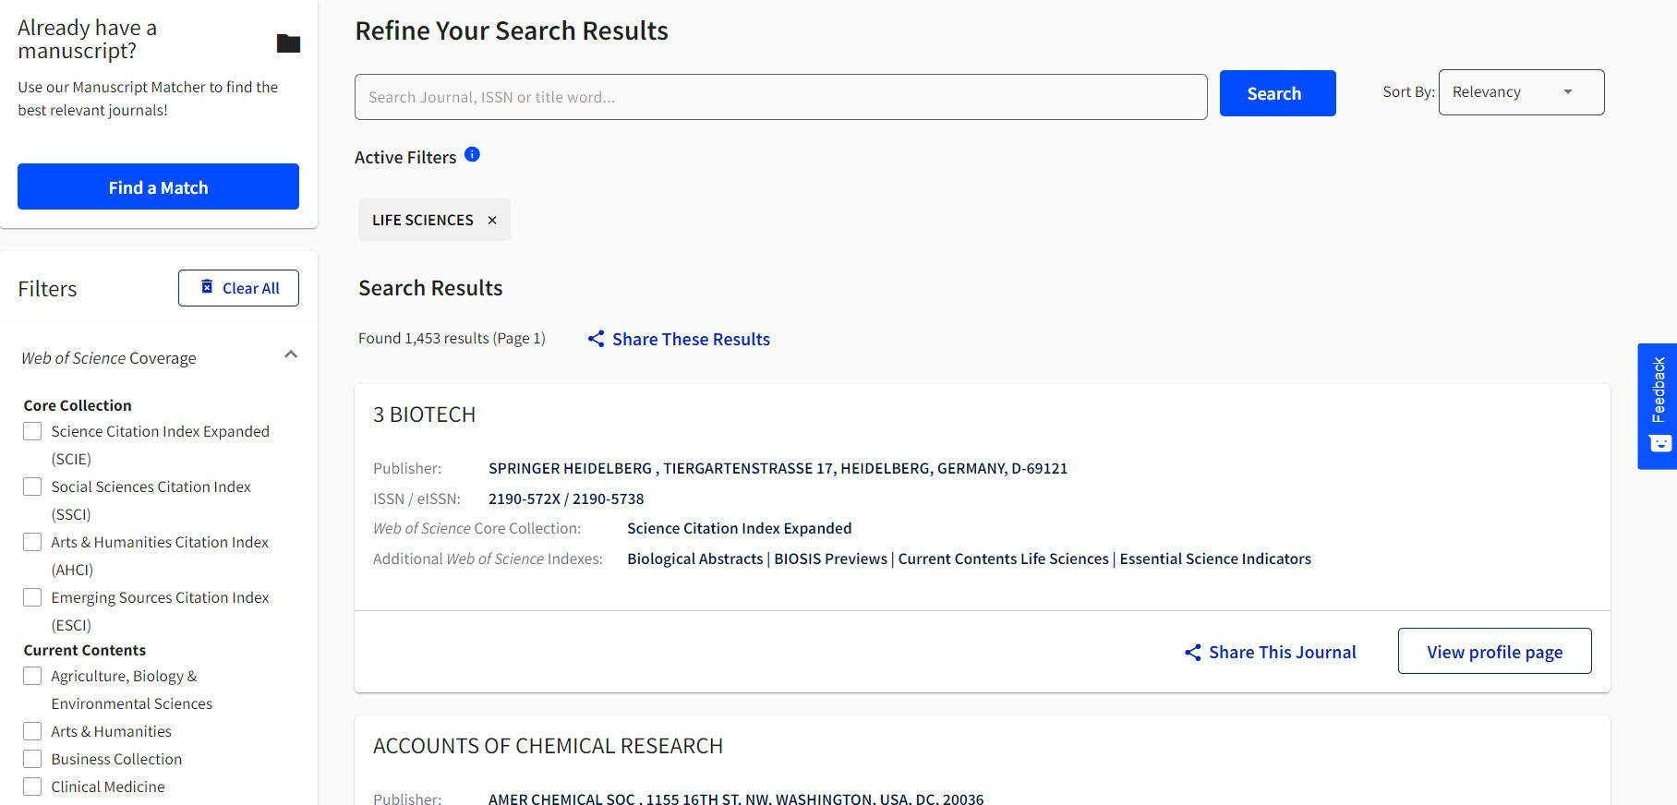
How to Find Literature (Academic SearchEngine)
Step 2. Go to “Filters” --> “Web of Science Coverage” --> “Current
Choose the categoryrelevant toyoursubjectarea

Slide 20
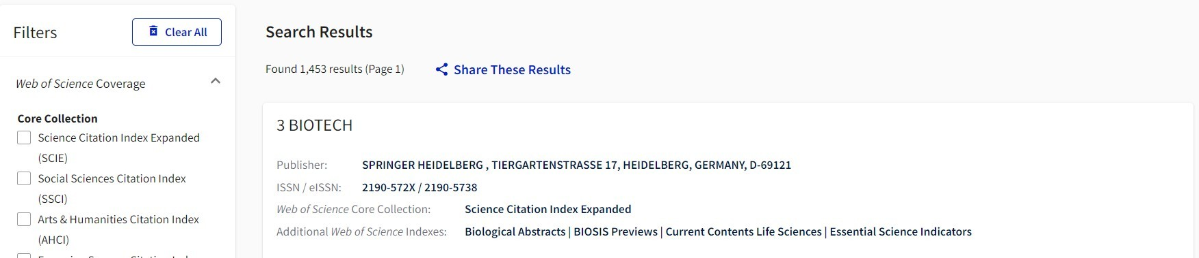
How to Find Literature (Academic SearchEngine)
Step 3. Journals indexed in the chosen category is displayed
Findthe journalyoupreferandcheckthe Web of Science CoreCollection
ISI (in UM context) only refers to these
Web of Science CoreCollection:
Science Citation Index Expanded(SCIE)
Social Sciences Citation Index(SSCI)
Arts & Humanities CitationIndex
As of now (2021), Emerging Sources Citation Index is NOT considered as ISI (in UM context)

Slide 21
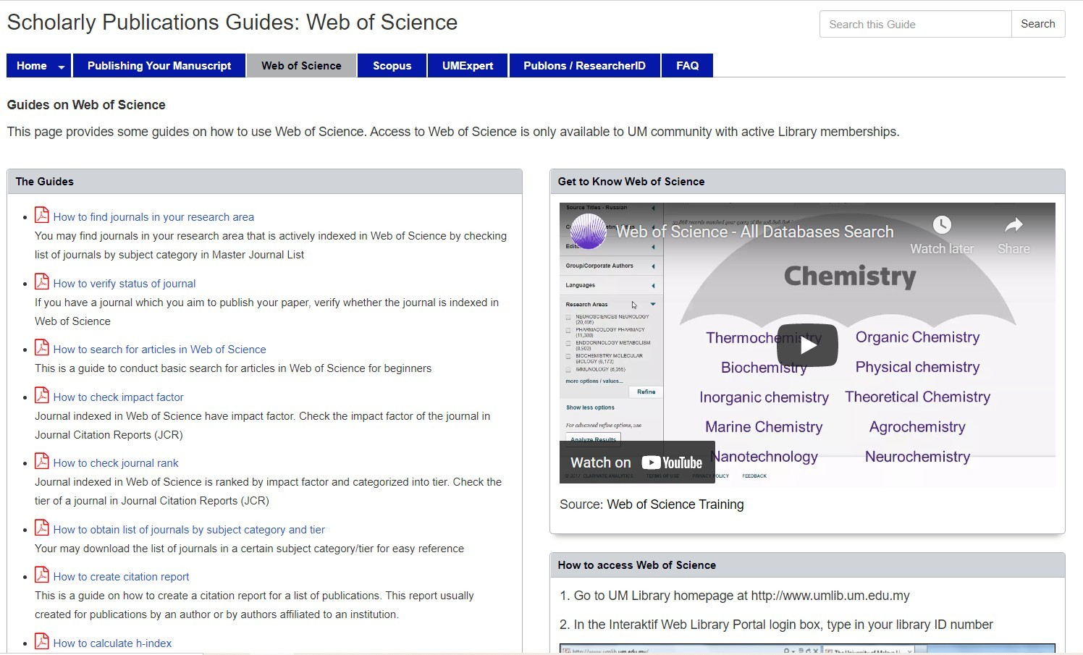
How to Find Literature (Academic SearchEngine)
More details on web of science you can find on
https://umlibguides.um.edu.my/researchguide/webofscience

Slide 22
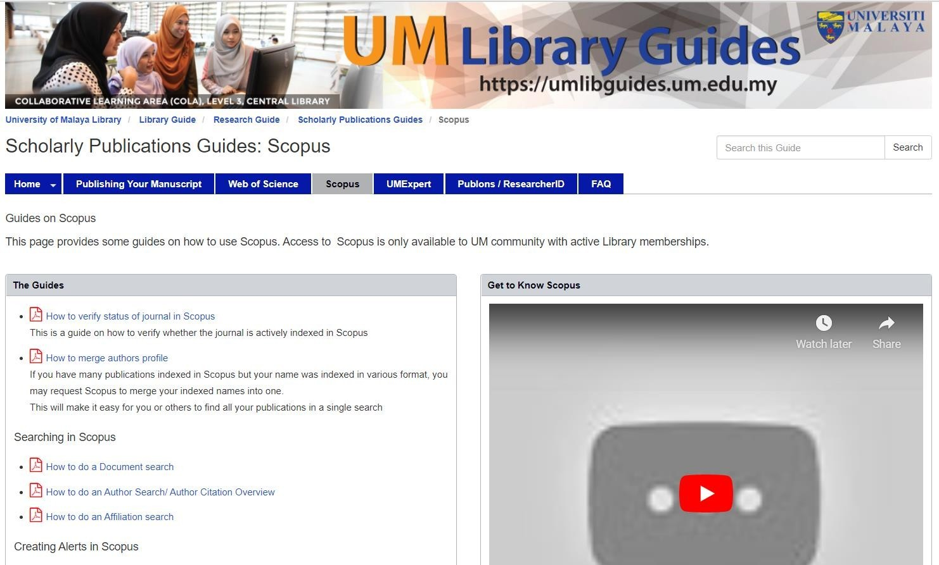
How to Find Literature (Academic SearchEngine)
2. Scopus
Elsevier’s abstract and citation database
Covers three types of sources book series, journals, and trade journals
All journals covered in the Scopus database (regardless of who they are published under)
reviewed each year to ensure high quality standards are maintained
Searches in Scopus also incorporate searches of patent databases Scopus gives four types of quality measure for each title those are h Index, CiteScore, SJR (SCImago Journal Rank) and SNIP (Source Normalized Impact per Paper)
More details on Scopus you can find on:
https://umlibguides.um.edu.my/researchguide/scopus

Slide 23
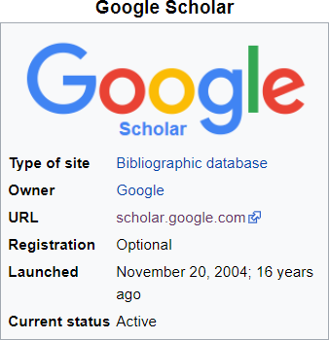

How to Find Literature (Academic SearchEngine)
3. Google Scholar
Google Scholar is most popular academic search engines
It's the power of Google searches applied to research papers and patents
Use keyword searches in google scholar (https://scholar.google.com/)
Coverage: approx. 389 million articles
Abstracts: only a snippet of the abstract is available
Related articles: ✔
References: ✔
Cited by: ✔
Links to full text:✔
Export formats: APA, MLA, Chicago,Harvard, Vancouver, EndNote, BibTeX

Slide 24
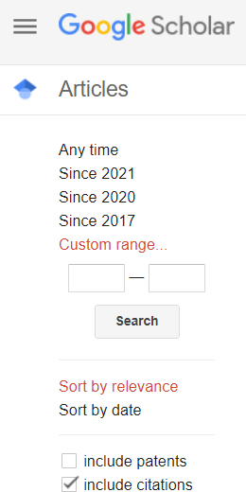
Search Tips Using Google Scholar
Finding recent papers
Your search results are normally sorted by relevance, not by date
To find newer articles, try the following options in the left sidebar:
click "Since Year"to show only recently published papers, sorted by relevance
click"Sort by date" to show just the new additions, sorted by date

Slide 25
Search Tips Using Google Scholar
Use technical words from secondary or
tertiary sources for better search
If you're new to the subject, pick up the terminology from secondary sources or tertiary sources e.g. Wikipedia article
E.g. for “flower colour" might suggest a Scholar search for “pigment synthesis“ or “anthocyaninbiosynthesis”

Slide 26
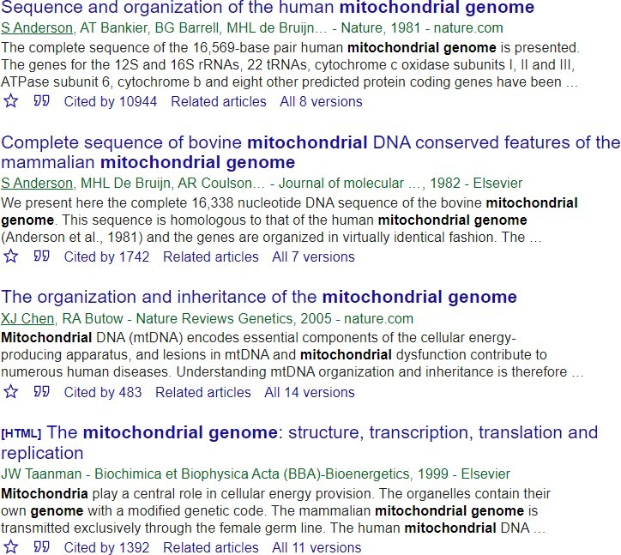
Search Tips Using Google Scholar
Use references
If the search results are too specific for your needs, check out what they're citing in their "References" sections
Similarly, if the search results are too basic for you, click "Cited by" to see newer papers that referenced them
these newer papers will often be more specific
Explore! There's rarely a single answer to a research question
click "Related articles" or "Cited by" to see closely related work, or
search for author’s name and see what else they have written

Slide 27
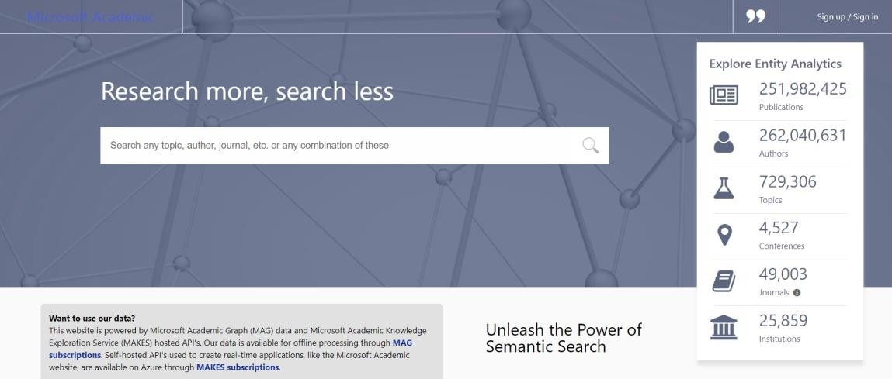
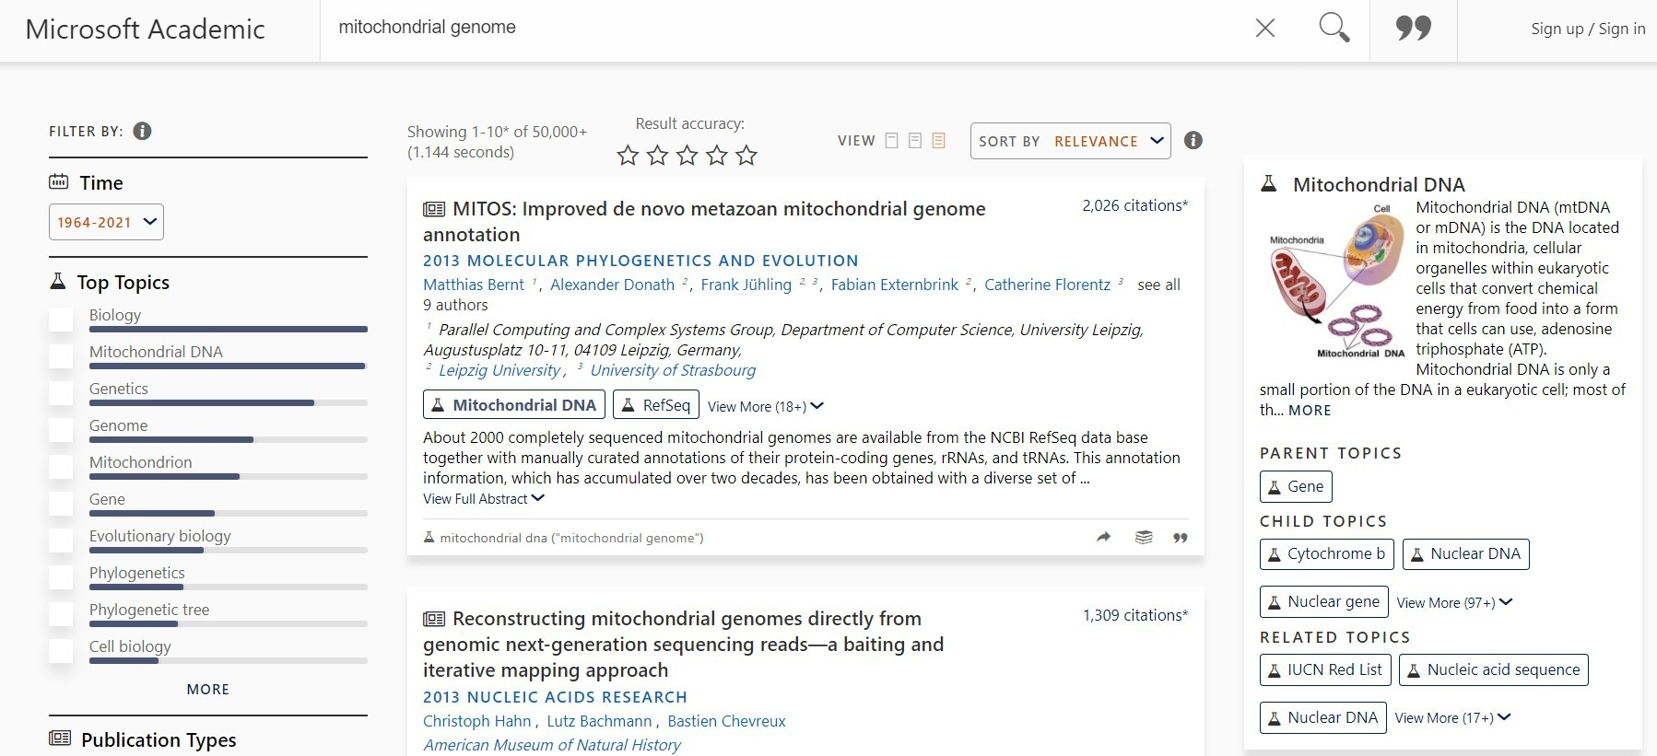
How to Find Literature (Academic SearchEngine)
4. Microsoft Academic
(https://academic.microsoft.com/home)
Microsoft Academic takes a different approach and generates for each paper that is indexed an overview page that allows to easily explore top citing articles and references of the article
Coverage: approx. 220 million articles
Abstracts: ✔
Related articles: ✔
References: ✔
Cited by: ✔
Links to full text:✔
Export formats: APA, MLA, BibTeX

Slide 28
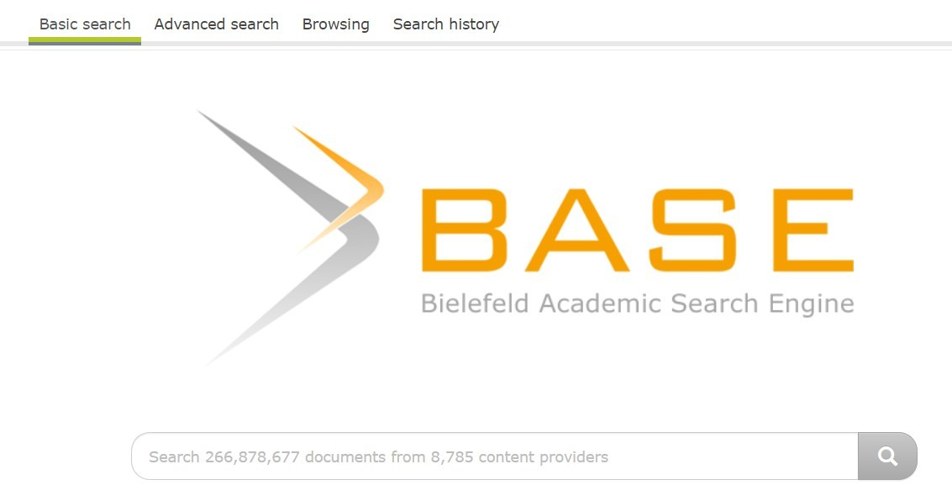
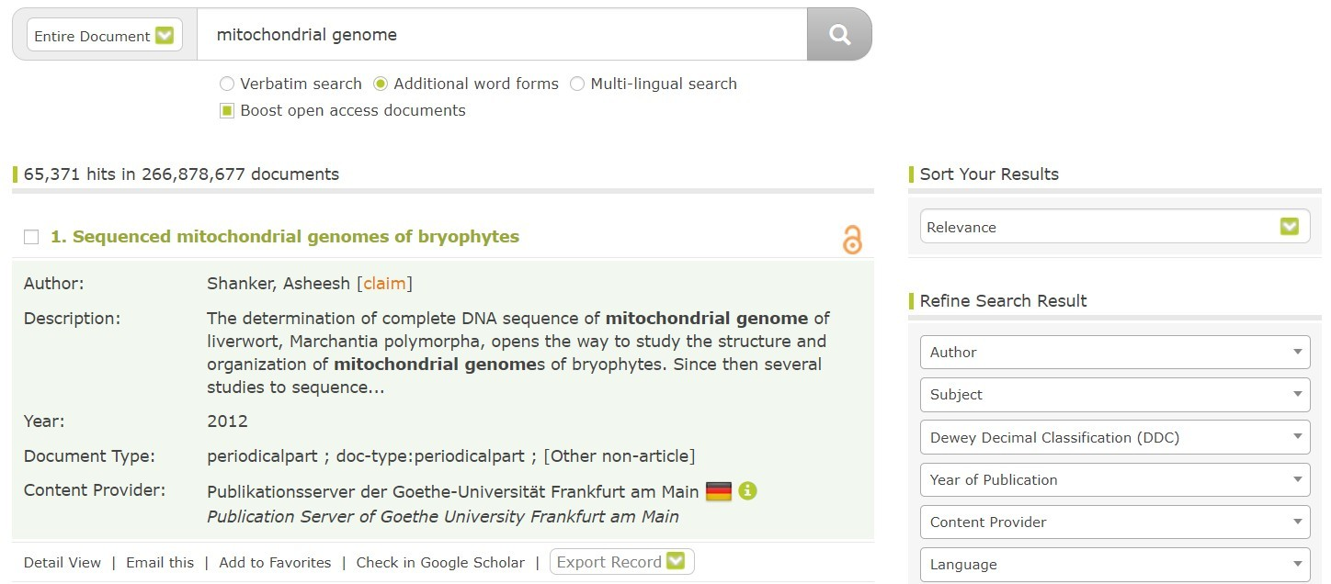



How to Find Literature (Academic SearchEngine)
5. Base (https://www.base-search.net/)
BASE is hosted at Bielefeld University in Germany and that's where it name stems from (Bielefeld Academic Search Engine)
Coverage: over 100 million articles
Abstracts: ✔
Related articles:
References:
Cited by:
Links to full text:✔
Export formats: RIS, BibTeX

Slide 29
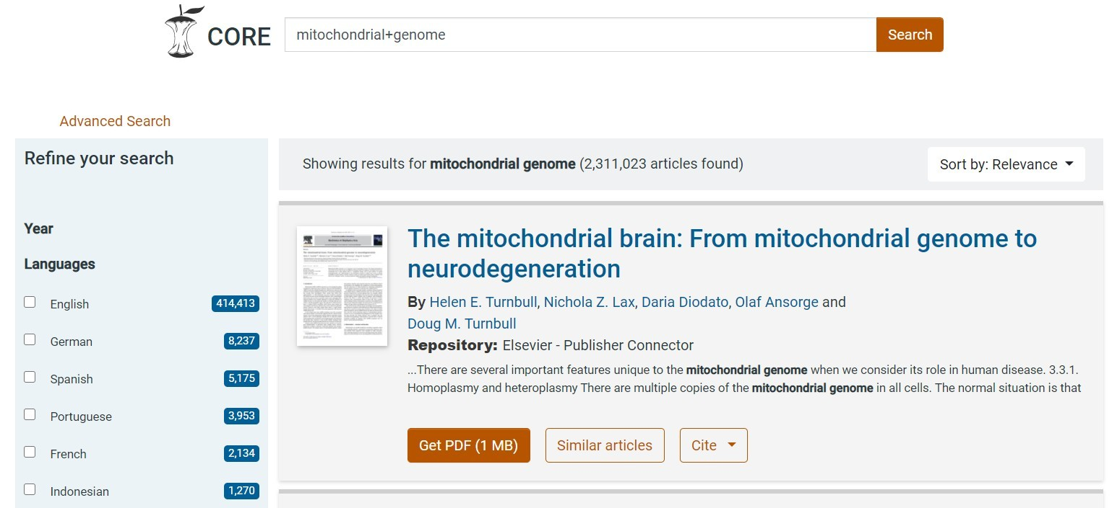
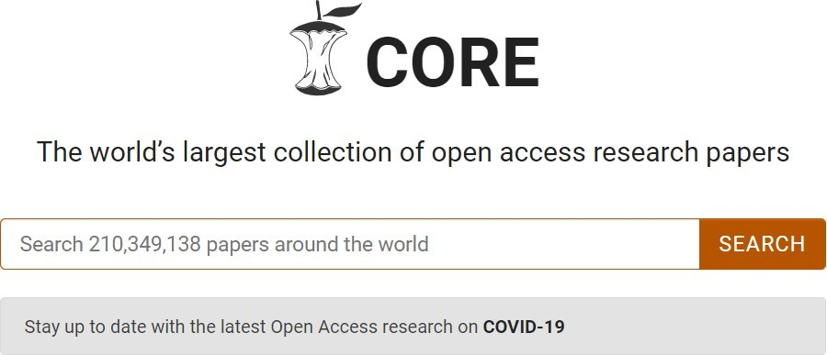


How to Find Literature (Academic SearchEngine)
6. CORE (https://core.ac.uk/)
CORE is an academic search engine dedicated to open access research papers
For each search result a link to the full text PDF or full text web page is provided
Coverage: over 125 million articles
Abstracts: ✔
Related articles: ✔
References:
Cited by:
Links to full text:✔(allarticles in CORE are open access)
Export formats: BibTeX

Slide 30
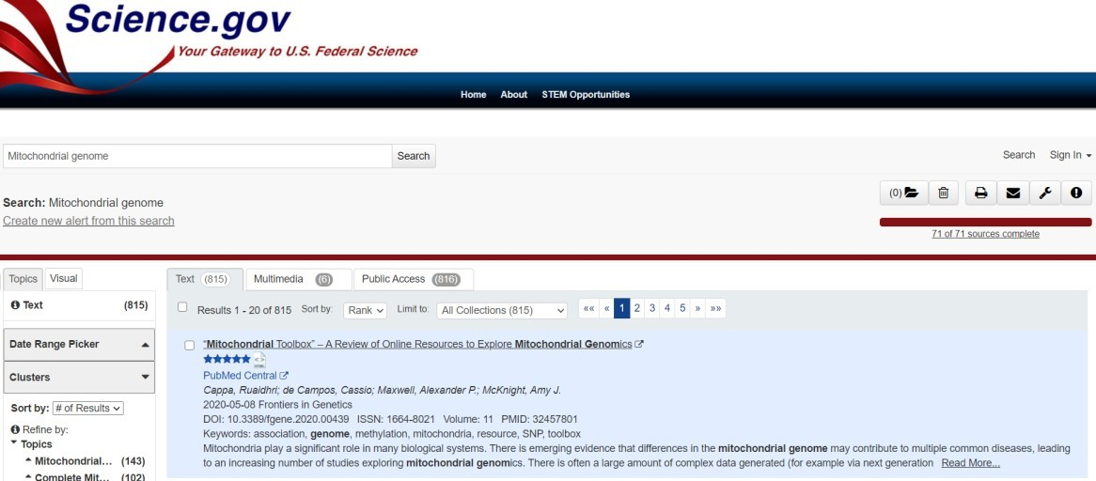
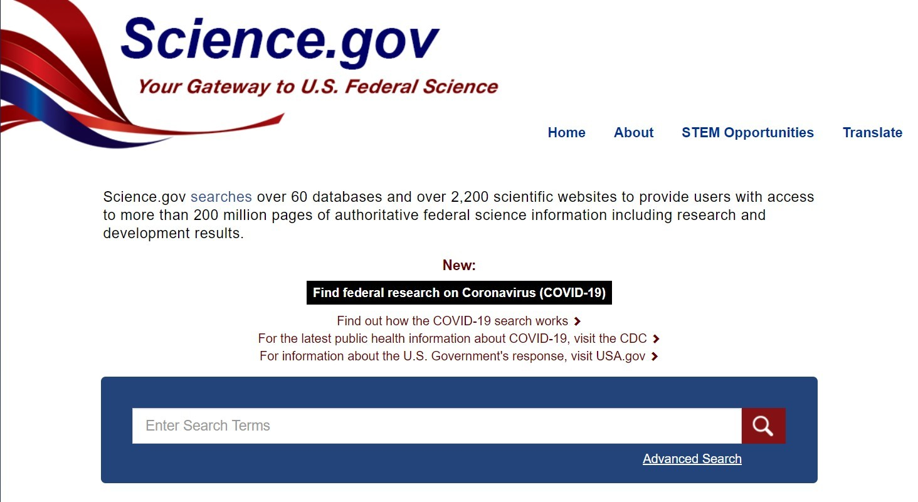


How to Find Literature (Academic SearchEngine)
7. Science.gov (https://www.science.gov/)
Science.gov is a good resource as it bundles and offers free access to search results from more than 15 U.S. federalagencies
There is no need any more to query all those resources separately!
Coverage: approx. 200 million articles &reports
Abstracts: ✔
Related articles:
References:
Cited by:
Links to full text:✔(available for some databases)
Export formats: APA, MLA,RIS, BibTeX (available for some databases)

Slide 31
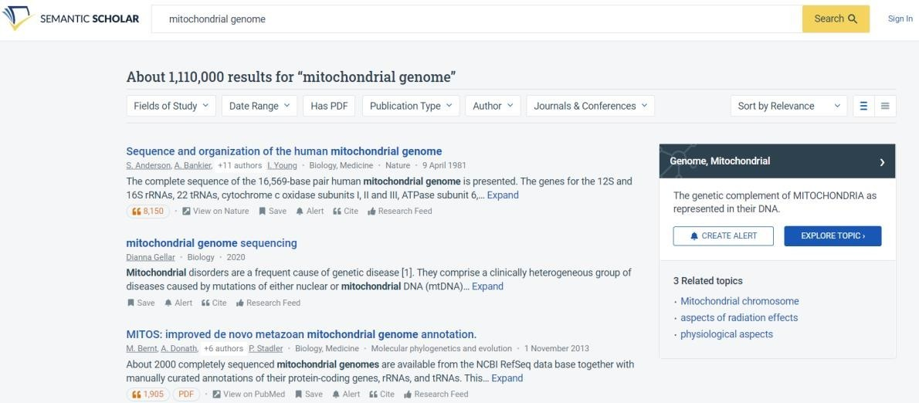

How to Find Literature (Academic SearchEngine)
8. Semantic Scholar
(https://www.semanticscholar.org/)
Semantic Scholar is the comparatively new search engines
Its mission is to provide more relevant and impactful search results using AI powered algorithms that find hidden connections andlinks between research topics
Coverage: approx. 173 million articles
Abstracts: ✔
Related articles: ✔
References: ✔
Cited by: ✔
Links to full text:✔
Export formats: APA, MLA, Chicago,BibTeX

Slide 32

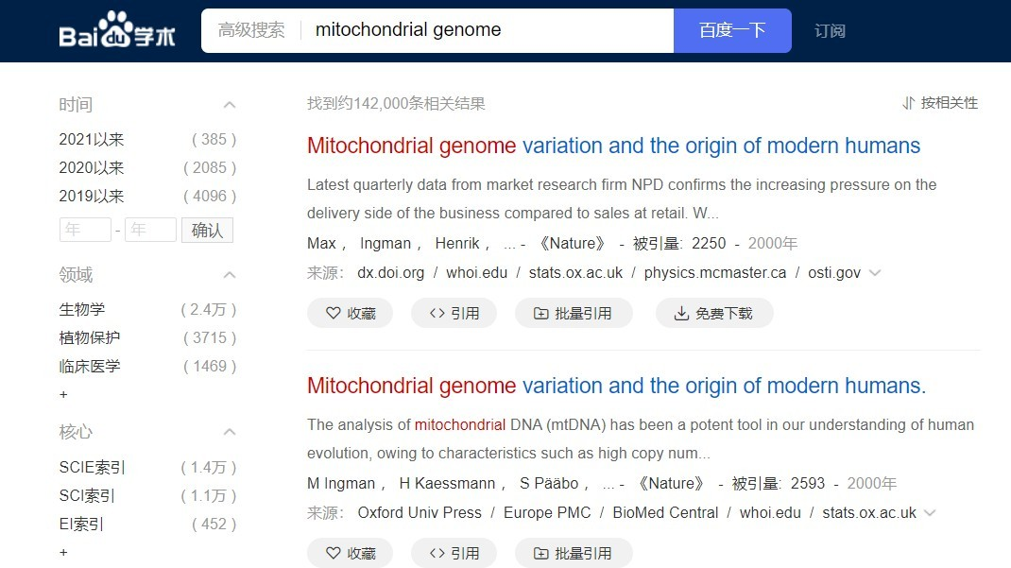
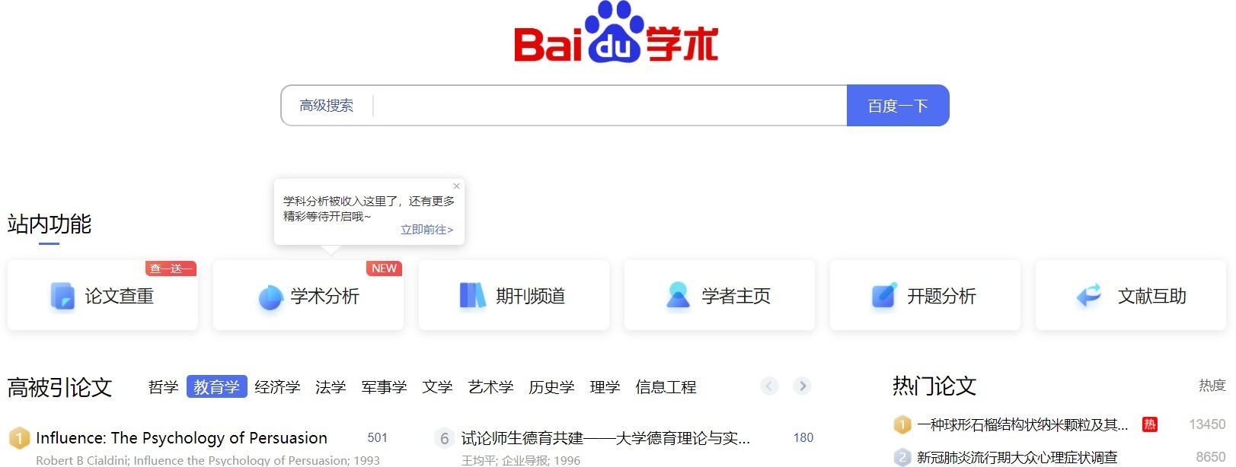
How to Find Literature (Academic SearchEngine)
Coverage: approx. 100 million articles
Abstracts: only snippets of the abstract are available
Related articles: ✔
References: ✔
Cited by:
Links to full text:✔
Export formats: APA, MLA, RIS,BibTeX
9. Baidu Scholar
(https://xueshu.baidu.com/)
Although Baidu Scholar's interface is in Chinese, its index contains research papers in English as well as Chinese

Slide 33
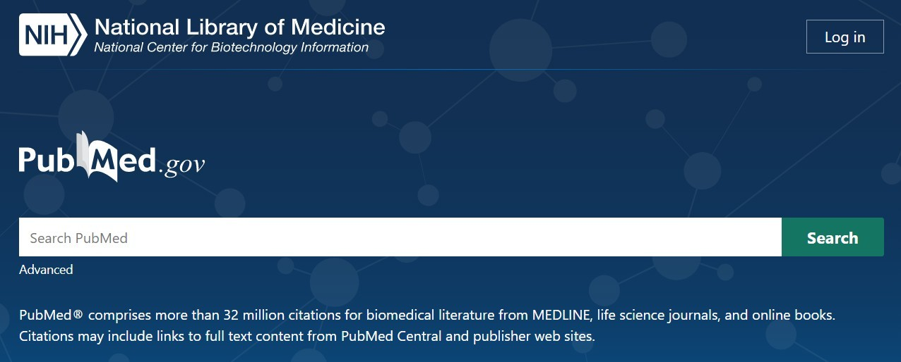
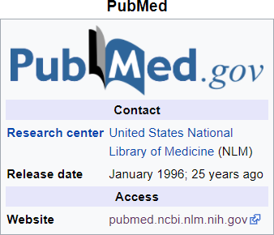
How to Find Literature (Academic SearchEngine)
10. Pubmed
(https://pubmed.ncbi.nlm.nih.gov/)
PubMed is a free search engine accessing primarily the MEDLINE database of references and abstracts on life sciences and biomedicaltopics
The United States National Library of Medicine (NLM) at the National Institutes of Health maintains the database as part of the Entrezsystem of information retrieval

Slide 34
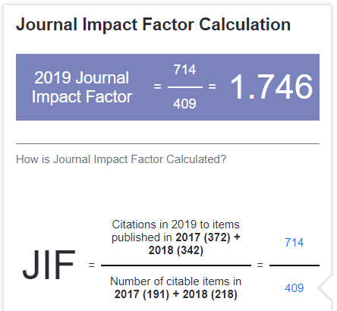
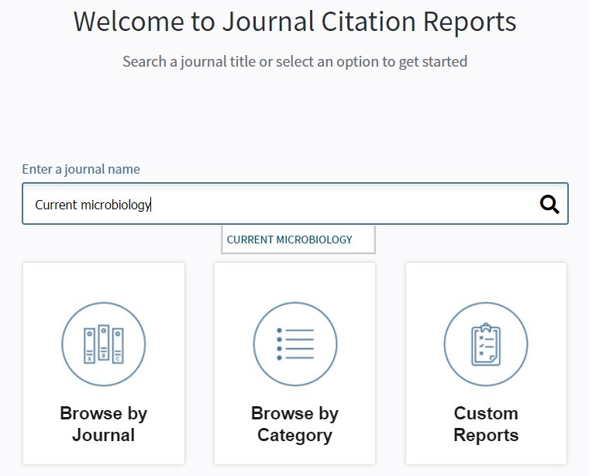
How to evaluate the reliability of literature sources
Journal ranking is widely used in academiccircles in the evaluationof an academic journal's impact and quality
Journal is indexed in an indexing database such as ISI (International scientific indexing), Scopus or Scimago
Impact factor (IF) – most widely recognized indicator of journal prestige and influence
Quartile rankings derived for each journal in each of its subject categories according to which quartile of the IF distribution the journal occupies for that subjectcategory
Q1 = the top 25% of the IF distribution
Q2 = middle high position (between top 50% and top 25%)
Q3 = middle low position (top 75% to top 50%)
Q4 = the lowest position (bottom 25% of the IF distribution)

Slide 35
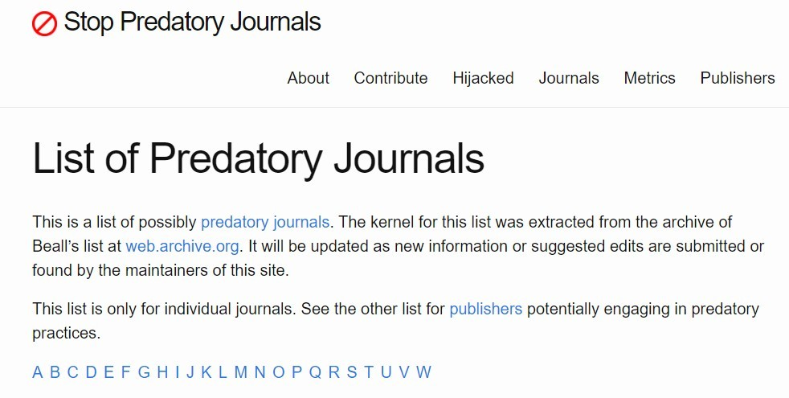
Beware of Predatory Journals
https://predatoryjournals.com/journals/
Charge authors publication fees for rapid electronic publication BUT
offer no editorialsupport
often NO OR SHODDY PEER REVIEW
Manuscripts are published as soon as the APC has been paid
Not indexed in the major bibliographic databases
e.g. PubMed, Web of Science orScopus
articles could not be traced
As a responsible researcher – not use or publish papers in those journals
harmful to you
publications in such journals usually do not count for doctoral theses or grant applications

Slide 36
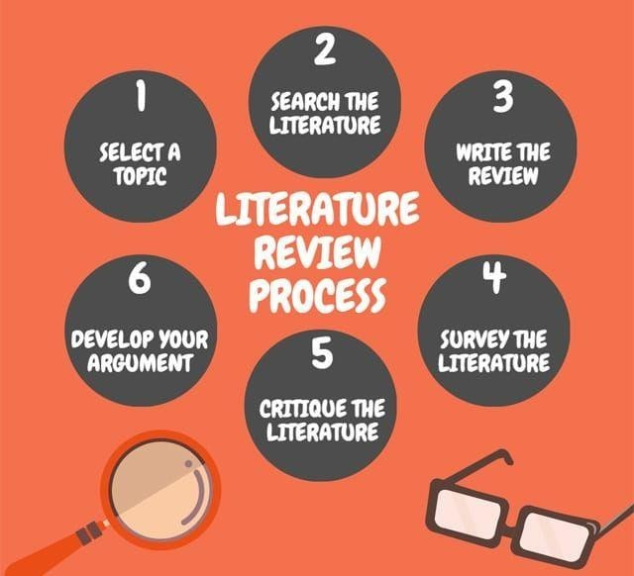
Literature ReviewProcess
https://peachyessay.com/blogs/7-tips-for-writing-your-dissertation-literature-review/

Slide 37
Final Checklist For Literature Review
1. Fulfilled the purpose of the
literature review?
2. Is it written at a level appropriate to
its audience?
3. Are the fact correct?
4. Are allthe information
included relevant
5. Are the layout and presentation easy to read and understand?
6. Is the language clear, concise and
Academic?
7. Does the introduction adequately introduce
the topic?
8. Are the recommendations
reasonable?
9. Acknowledged all sources of information
through correct
referencing?
10. Checked spelling, grammar?
11. Carefully proof read the finaldraft?

Slide 38
Common Errors Made in theLiterature Review
Not logically organized
Not focused on the researchtopic
Few references or outdated references cited
Not written in author’s own words
Written like a series of disjointed summaries
No recent references are included
Relying too much on secondary sources
Overlooking sources other than academic journals
Searching too broad or too narrow of a topic
Inaccuracy in the compiling of reference information

Slide 39










Common structures: LR
Chronological: Organize by time
Thematic: Organize by theme
Methodological: Organize by methodology
Theoretical: Organize by theoretical approach

Slide 40




What the Examiners Look in a Review of Literature?
Is the literaturerelevant?
Is the review critical orjust descriptive?
Is it comprehensive?
How well has the candidate mastered the technical or theoreticalliterature?
Does it summaries the essentialaspects?
Does it link to thethesis?

Slide 41
Good Literature Review
1. Focused
The topic should be specific,present the ideas and findings closely
Concise
Ideas should be presented in effective and conciseway
Logical
The flow within and among paragraphs should be smooth and logical
Developed
Don’t leave the story on half-way
Current
Review should focus on currentwork

Slide 42
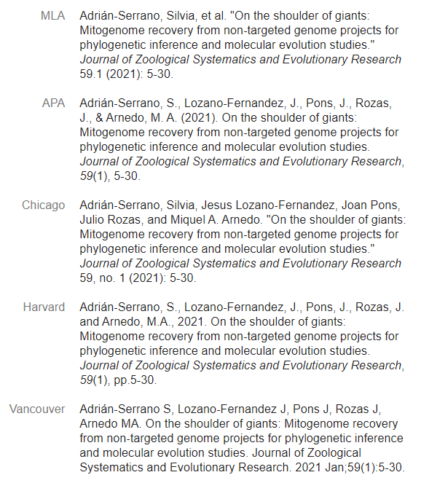

Referencing
A standardized method of acknowledging sources of information and ideas that you have used in your assignment in a way that uniquely identifies theirsource
Direct quotations, facts and figures as well as ideas and theories, from both published and unpublished works must be referenced
There are many acceptable forms of referencingstyles
When you cite Internet resources, you need to add date of access
E.g. World Spider Catalog (2020) Natural History Museum Bern. Available via http://wsc.nmbe.ch (accessed on 25 July 2020)
Authors Year
Article Title
Adrián-Serrano, S., Lozano-Fernandez, J.,Pons, J.,Rozas, J.,& Arnedo, M. A. (2021). On the shoulder of giants: Mitogenome recovery from non-targeted genome projects for phylogenetic inference and molecular evolution studies. Journal of Zoological
Systematics and Evolutionary Research, 59(1), 5-30.
Volume Issue Page No.
Journal
Title

Slide 43
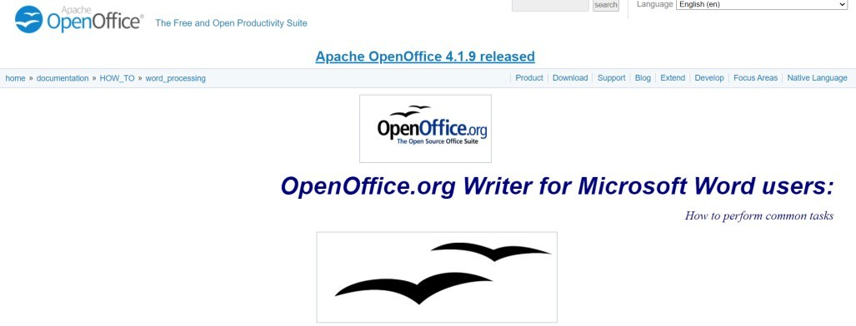

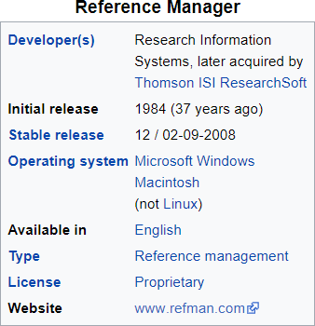
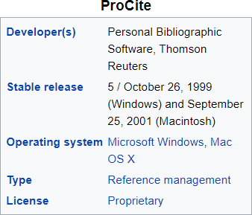
Save Your References While Writing LiteratureReview
Keep are cord of the literature you collected
Creating a reference
Word processor
OpenOffice.org.writer https://www.openoffice.org/documentation/HOW
_TO/word_processing/Word-to-OOo.html
MS Word
Software
Use a citation manager programlike “EndNote” https://www.youtube.com/watch?v=7e6-6QkcYm0
Pro-cite
ReferenceManager

Slide 44

Avoiding PlagiarismWhile Writing the Literature Review
Plagiarism
Turning in someone else's work as your own
Copying sentences or ideas from someone else without giving credit
Giving incorrect information about the source of a quotation
Changing words but copying the sentence structure of a source without giving credit
Copying so many words or ideas from a source that it makes up the majority of your work,whether you give credit or not
Self plagiarism
Tools to check plagiarism
Turnitin(https://www.youtube.com/watch?v=_OmEaqqI3-c)
Dupli Checker
Copyleaks
Source: https://www.easybib.com/guides/5-stories-of- plagiarism-in-2017/

Slide 45
How to Avoid Plagiarism?
Take good notes
While researching,be sure to take noteof important quotes and information that you think you might use in your paper
Save the citation information the author, title,and pagenumber ,so that you can easily cite it in yourpaper
Cite correctly
Anytimeyou use words from another source,such as a Web site, book,journal article, you must give proper credit to the source

Slide 46
How to Avoid Plagiarism?
Use quotes effectively
Changing a few words here and there is not enough to avoid plagiarism. Either put the exact phrase you are quoting in quotation marks or rewrite it entirely in your own words
Quoting extensively from another source,even if you do it properly ,isnot appropriate for a research paper.
Use quotations to support your arguments or clarify important points, but createyour own argument using your own words." (Penn State,2012)
Paraphrase correctly
"In a paraphrase, you rewrite what someone else has said in your own way. Just as you have a personality that is different from everyone else's, you as a writer have your own voice and style. When you write, even when you are paraphrasing, your writing should sound like it came from you,not fromsomeone else." (Penn State,2012)

Slide 47
End of Lecture 4

